Slide 1
Megha Institute of Engineering and Technology for Women- Ghatkesar
  Static Keystroke Dynamic Authentication Model to Authenticate User During Password Change
Presented by
Guided by
V. Sai sneha (21RP1A05B8)
S. Kavyanjali (21RP1A05A4)
P. Shruthi (21RP1A0596)
N. Himabindu (21RP1A0587)
P. Venu Madhav
Computer Science Engineering

Slide 2
  Content
Abstract
Introduction
Existing System
Disadvantages of Existing System
Proposed System
Advantages of Proposed System
System Requirements
Implementation
Testing / Experimentation
Results
Future Enhancement
Conclusion
References
2

Slide 3
  1. Abstract
Keystroke dynamics is considered as a supporting factor of authentication. Especially in the static keystroke dynamics, the user is identiﬁed by using the timing featured, which is captured while the user enters the login ID and password. To achieve this, the user proﬁle needs to be created with timing features. However, in a scenario like a change of password where nearly no keystroke timing data is available, non-conventional features may be helpful. This article focuses on using non- conventional features such as NumLock key, Shift key, Capslock key, etc, for identifying users during a change of password. The paper also details how to capture the non-conventional features in static keystroke dynamics and build a model that can be used in the change of password.
3

Slide 4
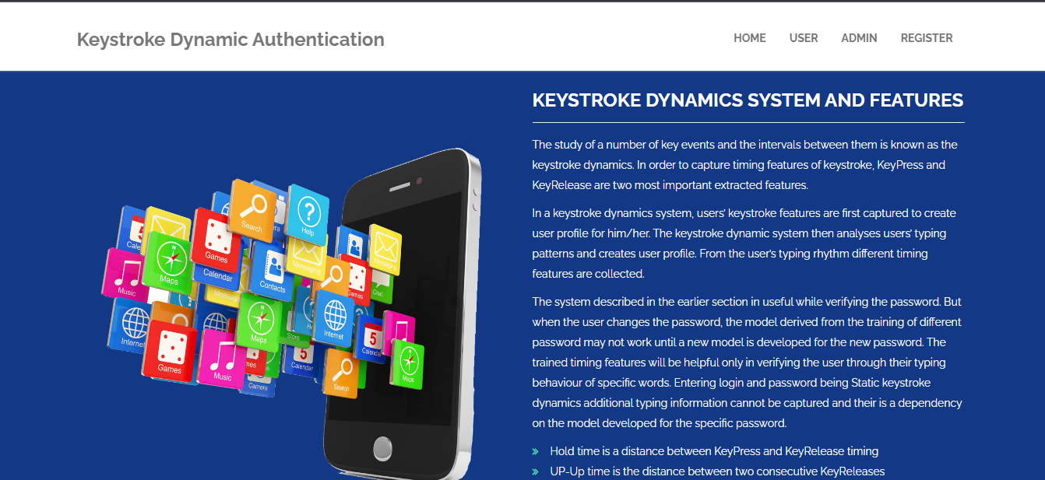
  2. Introduction
As password based authentication has many limitations many times to strengthen the authentication, multi factor authentication is used.
Password based authentication is the most frequently used authentication method for providing access to personal computers, online services and Internet access.
Here we use a support factor of authentication is keystroke dynamics, which is based on behavioral characteristics of a user.
There are two types of key stroke dynamics: Static and Continuous .In the static keystroke dynamics, the typing rhythm of a user is captured only at login time.
4

Slide 5
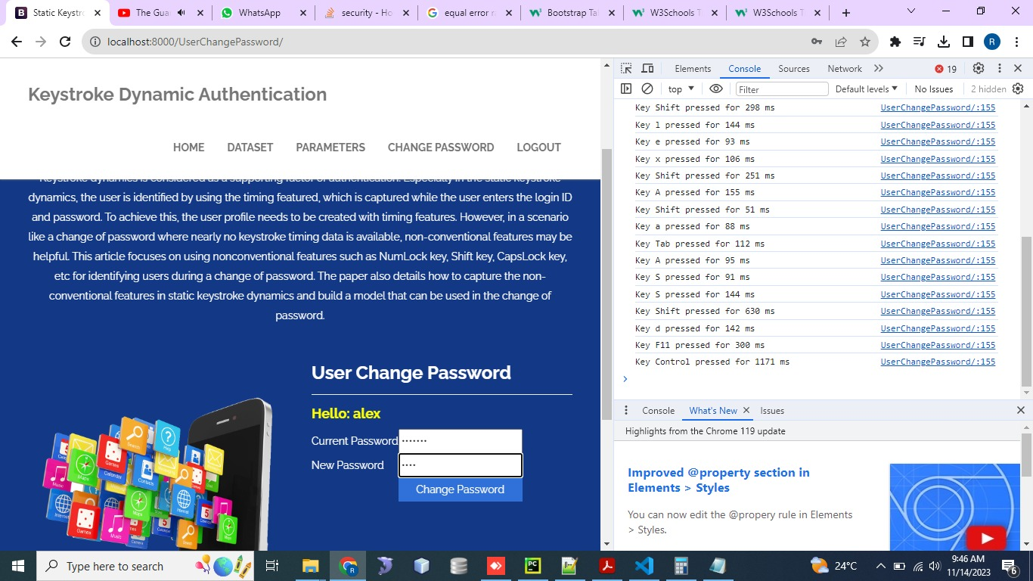
  3. Existing System
During enrollment, users establish a baseline profile through static keystroke data.
When changing the passwords, users provide dynamic keystroke data by typing a specific prompt.
The overall aim is to provide a secure, user-friendly, and privacy-compliant solution for enhanced user authentication during password changes.
5

Slide 6
  4. Disadvantages of Existing System
Firstly, keystroke dynamics can be affected by variations in user behavior due to stress, fatigue, or changes in typing patterns, leading to false rejections or acceptances.
Secondly, the system may struggle with accommodating users who have inconsistent typing habits or disabilities, reducing accessibility.
Additionally, enrollment requires a significant amount of static data, which may lead to user frustration and hinder adoption.
6

Slide 7
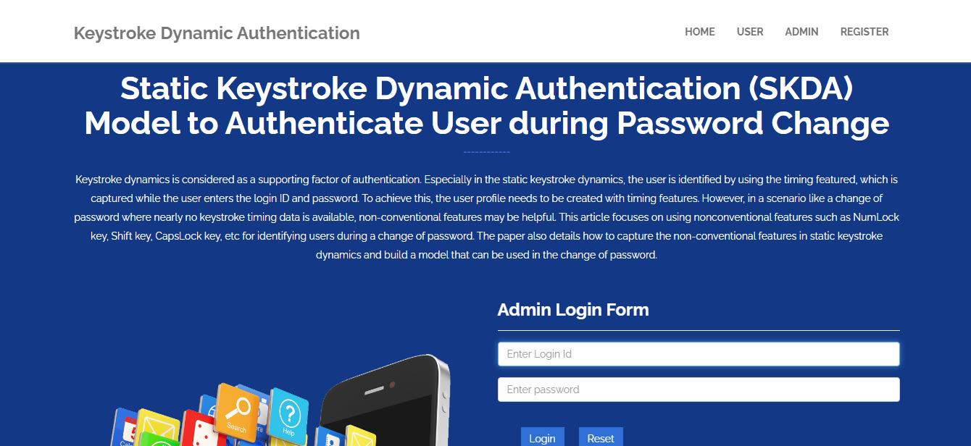
  Admin Login:
7

Slide 8
  5. Proposed System
The proposed SKDA system combines static keystroke dynamics and dynamic authentication for enhanced user verification during password changes.
. The system compares this dynamic data with the baseline to authenticate the user, allowing for a secure password update
Emphasis is placed on security measures, positive user experience, continuous improvement, and adherence to privacy regulations with user consent for data collection.
, 8

Slide 9
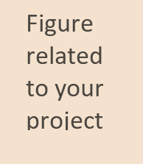
  6. Advantages of Proposed Systems
Emphasis is placed on security measures, positive user experience, continuous improvement, and adherence to privacy regulations with user consent for data collection.
By combining static and dynamic keystroke dynamics, it strengthens security through multi-layered verification, reducing the risk of unauthorized access.
The use of a baseline profile ensures that authentication remains accurate over time, even if minor variations in typing occur.
The system also supports continuous improvement through adaptive learning, making it more effective with frequent use.
9

Slide 10
  7. System Requirements
Operating system : Windows 10.
Coding Language : Python.
Front-End : Html. CSS
Designing : Html,css,javascript.
Data Base : SQLite.
10

Slide 11
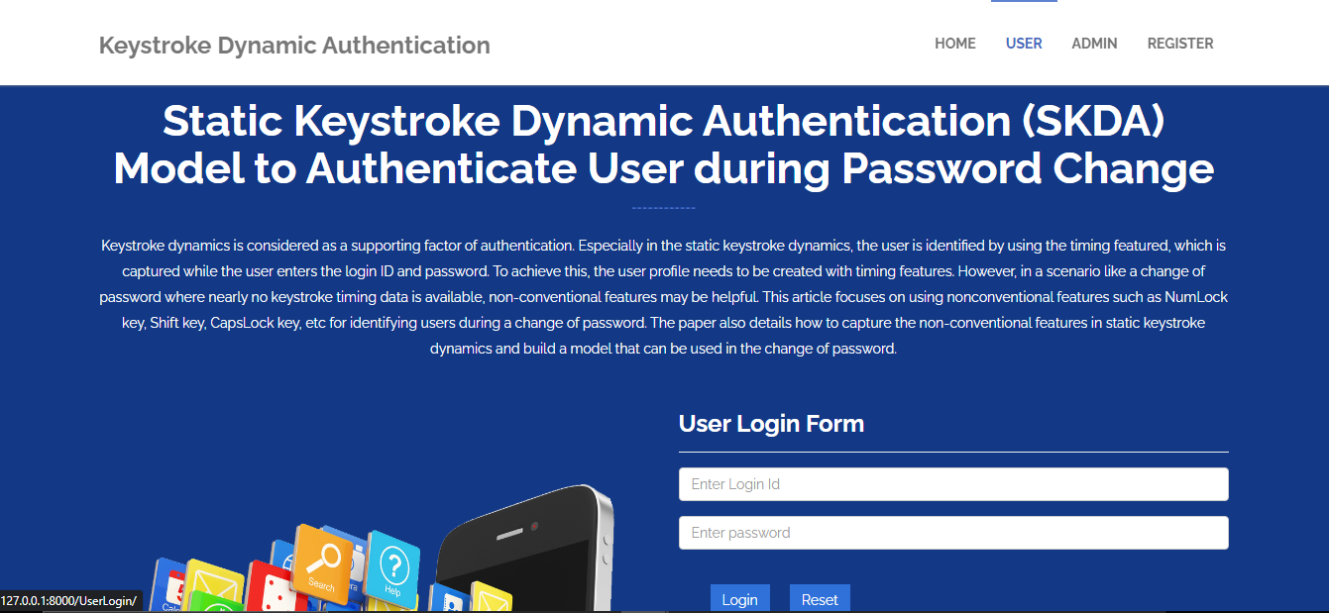
  8. Implementation
MODULES:
Admin > User

Slide 12
  9. Testing / Experimentation
S.no | Test Case | Excepted Result | Result | Remarks(IF Fails)
1 | User Register | If User registration successfully. | Pass | If already user email exist then it fails.
2 | User Login | If Username and password is correct then it will getting valid page. | Pass | Un Register Users will not logged in.
3 | View Parameter Results by User | Parameter Results will be displayed by the user | Pass | Results not true failed
4 | View Parameter Results by Admin | Parameter Results will be displayed by the admin | Pass | Results not true Failed
5 | Admin login | Admin can login with his login credential. If success he get his home page | Pass | Invalid login details will not allowed here
6 | Admin can activate the register users | Admin can activate the register user id | Pass | If user id not found then it won’t login.
12

Slide 13
  10. Results
Test Results: All the test cases mentioned above passed successfully. No defects encountered.
Acceptance Testing
User Acceptance Testing is a critical phase of any project and requires significant participation by the end user. It also ensures that the system meets the functional requirements.
13

Slide 14
  11. Future Enhancement
The future enhancements for the Static Keystroke Dynamic Authentication (SKDA) model involve a comprehensive strategy to elevate security, usability, and adaptability. By integrating additional behavioral biometrics and leveraging machine learning for continuous refinement, the model aims to keep pace with evolving user behaviors. Adaptive authentication policies, exploration of multi-factor authentication, and real-time anomaly detection contribute to a dynamic and responsive authentication system.
14

Slide 15
  12. Conclusion
In static keystroke dynamics, the user is authenticated based on the model generated from the timing features captured while entering the login and password. However, during the change of password, no data related to key press and release for the new password is available. This results in, the model available for static keystroke dynamics for the new password of the user.
15

Slide 16
  13.References
R. Joyce and G. Gupta, “Identity authentication based on keystroke latencies,” in Communications of the ACM, 33(2), 168-176, 1990.
S. Mondal and P. Bours, “Continuous authentication in a real world settings,” in Advances in Pattern Recognition, Eighth International Conference, pp. 1-6, 2015.
F. Monrose and A. D. Rubin, “Keystroke dynamics as a biometric for authentication,” in Future Generation computer systems, 16(4), 351-359, Elsevier Science, 2000.
16

Slide 17


